Slide 2
Chapter 1, LO1 key terms
Describe the medication aide’s role
Define the following terms:
medication aide (MA)
a healthcare worker, usually first trained as a nursing assistant, whose main task is administering medications to residents in a long-term care facility.
long-term care facility
a facility in which residents live and are able to receive 24-hour skilled care.
documenting
keeping a record of care provided.
PRN
abbreviation meaning as needed.

Slide 3
LO1, content 1
Describe the medication aide’s role
Medication aides may work in these types of facilities:
Long-term care facilities (nursing homes)
Assisted living facilities
Group homes
Prisons

Slide 4
LO1, content 2
Key Material 1-1: Key Tasks of a Medication Aide
Preparing and distributing medications ordered for residents
Observing residents as they take medications, helping as needed
Documenting medications taken by residents
Observing and reporting changes in residents, especially those that could be related to the effects of medications
Reporting anything that might be a risk to resident safety (e.g., resident refusing a medication or a mistake related to a medication)

Slide 5
LO1, content 3
Describe the medication aide’s role
Critical Thinking: Conversation Starter
How would the day-to-day tasks of an MA be different at different types of facilities?
What do you think the advantages or disadvantages would be of each type?

Slide 6
LO1, content 4
Describe the medication aide’s role
Remember these points about the medication aide’s role:
Some states allow MAs to perform nursing assistant tasks in addition to their medication duties and some do not
Some NA skills (observing and reporting, measuring vital signs) are also important to the MA’s role
Medication aides may also be called medication assistants, medication technicians, or other titles

Slide 7
LO1, content 5
Key Material 1-2: Tasks Not Allowed for Medication Aides
Giving medications to residents whose medical condition is changing or unstable
Deciding when to give PRN medications, or medications that are given only when a resident needs them
Giving medications by injection
Deciding what amount of medication (dose) to give a resident, or doing calculations to find the correct dose

Slide 8
LO2, key terms 1
Discuss professionalism and list examples of professional behavior
Define the following terms:
professional
having to do with work or a job.
personal
relating to life outside one’s job, such as family, friends, and home.
professionalism
the act of behaving properly when working.
person-centered care
a type of care that places the emphasis on the person needing care and his or her individuality and capabilities.

Slide 9
LO2, key terms 2
Discuss professionalism and list examples of professional behavior
Define the following terms:
confidential
private.
chain of command
the line of authority within a facility or agency.
conscientious
guided by a sense of right and wrong; principled.
delegate
to transfer responsibility to a person for a specific task.

Slide 10
LO2, content 1
Discuss professionalism and list examples of professional behavior
Professional behavior toward residents includes the following:
Providing person-centered care, or care that is sensitive to each resident’s particular needs
Keeping a positive attitude
Doing only assigned tasks that the MA is trained to do
Keeping all resident information private, or confidential
Always being polite and cheerful
Not discussing personal problems with residents or their family members

Slide 11
LO2, content 2
Discuss professionalism and list examples of professional behavior
Professional behavior toward residents (cont’d):
Not using personal phones in residents’ rooms or in any resident care area
Not using profanity, even if a resident does
Listening to the resident
Calling a resident by preferred names and not using disrespectful nicknames
Using the pronouns a resident prefers
Never giving or accepting gifts
Always explaining care before providing it
Following practices, such as handwashing, to protect oneself and residents

Slide 12
LO2, content 3
Discuss professionalism and list examples of professional behavior
Professional behavior toward employers includes the following:
Completing tasks efficiently
Always following policies and procedures
Documenting and reporting carefully and correctly
Reporting problems with residents or tasks
Reporting anything that keeps a medication aide from completing duties
Asking questions when necessary

Slide 13
LO2, content 4
Discuss professionalism and list examples of professional behavior
Professional behavior toward employers (cont’d):
Taking directions or feedback without becoming upset
Being clean and neatly dressed and groomed
Always being on time
Communicating when sick/delayed/unable to come to work
Following the chain of command
Participating in continuing education programs
Being a positive role model for the facility

Slide 14
LO2, content 5
Discuss professionalism and list examples of professional behavior
Critical Thinking: Conversation Starter
What traits does a person need to succeed as a medication aide?
Why are these traits important?
What do they look like in action?
Is there a single most important trait?

Slide 15
LO2, content 6
Discuss professionalism and list examples of professional behavior
Critical Thinking: Role Play
In pairs, role play the following situations:
A doctor visiting a resident tells you she wants you to contact the pharmacy and order a new medication for the resident. (Roles: doctor and MA)
You live in a state in which MAs can administer nebulized medications, but you have never used the nebulizer at your facility. Your supervisor assigns a resident with an order for nebulized medications to you. (Roles: supervisor and MA)

Slide 16
LO2, content 7
Discuss professionalism and list examples of professional behavior
Critical Thinking: Role Play (cont’d)
A nurse is about to administer an insulin injection when an emergency with another resident requires his attention. He tells you to go to the resident’s room and administer the injection. MAs are not allowed to give injections in your state. (Roles: nurse and MA)
A resident tells you she has a horrible headache and needs Tylenol. Tylenol is listed on the resident’s medication administration record as a PRN medication for headache, but the nurse is not available at the moment to approve it. The resident wants you to give her the Tylenol right away. (Roles: resident and MA)

Slide 17
LO3, key terms
Discuss the facility chain of command regarding medication administration
Define the following terms:
liability
a legal term that means someone can be held responsible for harming someone.
scope of practice
defines the tasks that healthcare providers are legally allowed to do as permitted by state or federal law.
nursing process
an approach to providing effective care for a resident on an ongoing basis; involves assessment, diagnosis, planning, implementation, and evaluation.

Slide 18
LO3, content 1
Discuss the facility chain of command regarding medication administration
REMEMBER:
The chain of command protects residents from harm and protects employees and employers from liability.
How does the chain of command promote safety?

Slide 19
LO3, content 2
Discuss the facility chain of command regarding medication administration
These are important points about medication aide scope of practice:
MAs must not perform tasks outside scope of practice, not listed in care plan, or not assigned, no matter who requests the task
MAs cannot diagnose illness, prescribe medications, or determine/calculate dose
MAs cannot discuss the treatment plan with the resident or family. Questions about how a medication works or why it was prescribed should be referred to a supervisor

Slide 20
LO3, content 3
Discuss the facility chain of command regarding medication administration
The nursing process includes the following steps:
Assessment
Diagnosis
Planning
Implementation
Evaluation

Slide 21
LO3, content 4
Discuss the facility chain of command regarding medication administration
REMEMBER:
Communication between team members and the resident informs the nursing process and improves care.

Slide 22
LO3, content 5
Discuss the facility chain of command regarding medication administration
Critical Thinking: Conversation Starter
Does the medication aide have a role in the nursing process?
Can you think of examples of ways an MA might contribute to the nursing process? What kinds of changes might be made based on an MA’s input?

Slide 23
LO4, key terms
Discuss communication, team building, and interpersonal relationships
Define the following terms:
verbal communication
Communication involving the use of spoken or written words or sounds.
nonverbal communication
Communication without using words.
cliché
phrase that is used over and over again and does not really mean anything.

Slide 24
LO4, content 1
Discuss communication, team building, and interpersonal relationships
REMEMBER:
Good communication skills involve being mindful of both verbal and nonverbal communication. Body language can communicate both positive and negative messages.

Slide 25
LO4, content 2
Discuss communication, team building, and interpersonal relationships
These types of nonverbal communication are generally considered to send a positive message:
Standing up straight with arms relaxed
Leaning toward speaker
Making eye contact
Nodding or smiling
Offering handshake or greeting
Taking notes
Using a cheerful tone of voice
Smiling

Slide 26
LO4, content 3
Discuss communication, team building, and interpersonal relationships
These types of nonverbal communication are generally considered to send a negative message:
Slouching or resting head in hands
Leaning back from the speaker
Crossing arms over chest
Avoiding eye contact, looking down
Checking the time
Not acknowledging the other person
Picking at or playing with something
Using an angry tone of voice
Frowning, wincing, rolling eyes

Slide 27
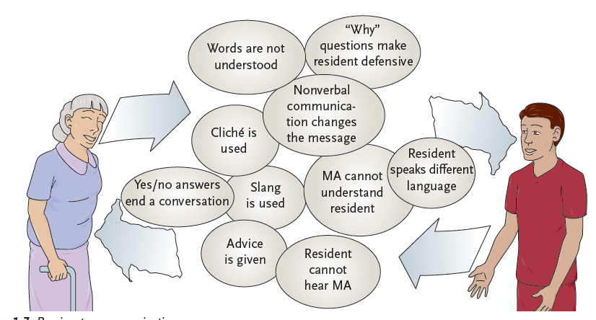
LO4, content 4
Key Material 1-3: Barriers to Communication

Slide 28
LO4, content 5
Discuss communication, team building, and interpersonal relationships
Following these guidelines will promote effective communication:
Be a good listener
Provide feedback
Bring up topics of concern
Let some pauses happen
Tune in to other cultures
Accept a resident’s religion or lack of religion
Understand the importance of touch
Ask for more information as needed
Make sure communication aids are clean and in proper working order

Slide 29
LO4, content 6
Discuss communication, team building, and interpersonal relationships
REMEMBER:
MAs play an important role in promoting resident safety through careful communication. Listen carefully and report to the nurse if residents are experiencing new symptoms or behaving differently.

Slide 30
LO4, content 7
Discuss communication, team building, and interpersonal relationships
Following these guidelines will help resolve conflict in the workplace:
Address conflict early on
Plan to discuss the issue at the right time
Agree not to interrupt
Do not get emotional
Check your body language
Keep the focus on the issue at hand
Recognize and accept individual differences
Think of ways the conflict can be resolved and be prepared to compromise

Slide 31
LO4, content 8
Discuss communication, team building, and interpersonal relationships
Critical Thinking: Conversation Starter
Think about times when you have had to resolve conflict
In a personal relationship
With a coworker
With a supervisor
With a resident or family member
Did these different types of conflict require different approaches? Different skills?

Slide 32
LO5, key terms
Explain policy and procedure manuals
Define the following terms:
policy
a course of action that should be taken every time a certain situation occurs.
procedure
a method or way of doing something.

Slide 33
LO5, content 1
Explain policy and procedure manuals
The following are examples of common policies:
All resident information must remain confidential
The care plan must always be followed
MAs should not do tasks not included in their job descriptions
MAs must report important events or changes in residents to a nurse

